Slide 1
Federalism

Slide 2
Federalism
Power is divided between the national government and the state governments

Slide 3
Three Types

Slide 4
State— “Reserved”
Shared— “Concurrent”
National— “Delegated”
Three Types

Slide 5
State— “Reserved”
Shared— “Concurrent”
National— “Delegated”
Three Types

Slide 6
State— “Reserved”
Shared— “Concurrent”
National— “Delegated”
Three Types

Slide 7
State— “Reserved”
Shared— “Concurrent”
National— “Delegated”
Three Types

Slide 8
State— “Reserved”
Shared— “Concurrent”
National— “Delegated”
Three Types

Slide 9
State— “Reserved”
Shared— “Concurrent”
National— “Delegated”
Three Types

Slide 10
National/Delegated

Slide 11
Expressed Powers—specifically given to government
National/Delegated
Notes:
Declare war, coin money, etc.

Slide 12
Implied Powers—not written, but based on expressed powers
Expressed Powers—specifically given to government
National/Delegated
Notes:
Ex:) Draft

Slide 13
Inherent Powers—powers the government has for being the government
Implied Powers—not written, but based on expressed powers
Expressed Powers—specifically given to government
National/Delegated
Notes:
Control immigration, gain territory, recognize other countries

Slide 14
*Necessary and Proper Clause: gives gov extra powers so long as those are “necessary” and “proper” to carrying out other laws.
National/Delegated
Notes:
Control immigration, gain territory, recognize other countries

Slide 15
Shared/Concurrent

Slide 16
Powers shared by both the national government and state governments.
Shared/Concurrent

Slide 17
State/Reserved

Slide 18
Powers not given to the national government
State/Reserved
Notes:
But remember: SUPREMACY CLAUSE

Slide 19
Full Faith and Credit Clause: states have to recognize, honor, and enforce one another’s actions
Powers not given to the national government
State/Reserved
Notes:
But remember: SUPREMACY CLAUSE

Slide 20
Privileges and Immunities Clause: states cannot discriminate against residents of other states
Full Faith and Credit Clause: states have to recognize, honor, and enforce one another’s actions
Powers not given to the national government
State/Reserved
Notes:
But remember: SUPREMACY CLAUSE

Slide 21
Admit New States

Slide 22
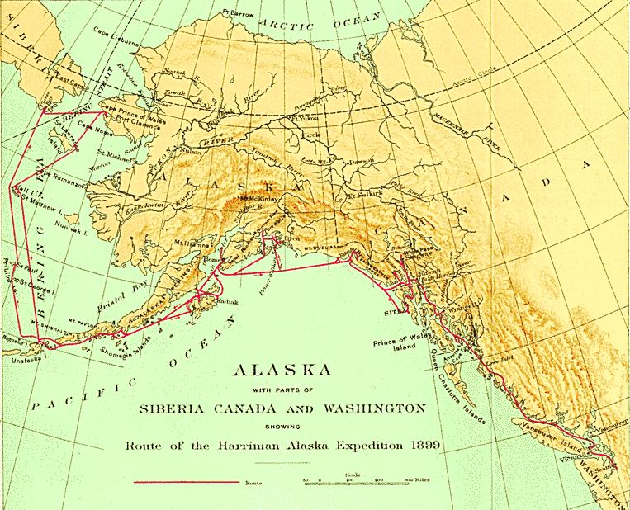
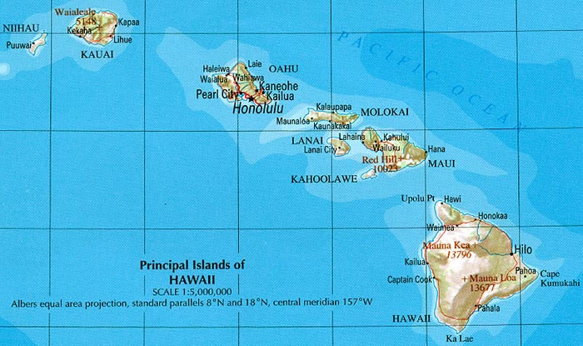
Delegated
Admit New States

Slide 23
Borrow Money

Slide 24
Concurrent
Borrow Money

Slide 25
Charter Banks

Slide 26
Concurrent
Charter Banks

Slide 27
Coin Money

Slide 28
Delegated
Coin Money

Slide 29
Conduct Elections

Slide 30
Reserved
Conduct Elections

Slide 31
Conduct Foreign Relations

Slide 32
Delegated
Conduct Foreign Relations

Slide 33
Declare War

Slide 34
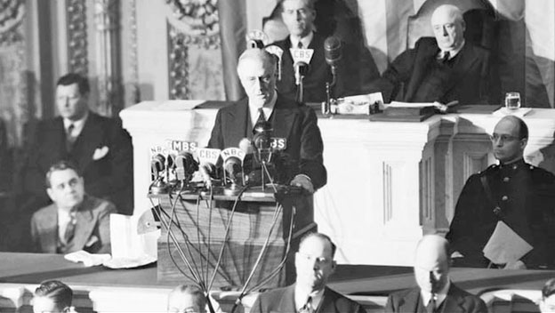
Delegated
Declare War

Slide 35
Establish Courts

Slide 36
Concurrent
Establish Courts

Slide 37
Establish Post Offices

Slide 38
Delegated
Establish Post Offices

Slide 39
Establish State Militias

Slide 40
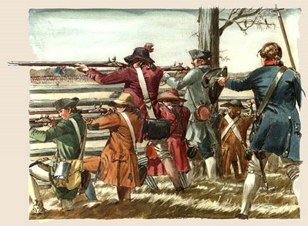
Reserved
Establish State Militias

Slide 41
Levy and Collect Taxes

Slide 42
Concurrent
Levy and Collect Taxes

Slide 43
Make and Enforce Laws

Slide 44
Concurrent
Make and Enforce Laws

Slide 45
Provide for General Welfare

Slide 46
Concurrent
Provide for General Welfare

Slide 47
Provide for Public Health, Safety, and Morals

Slide 48
Concurrent
Provide for Public Health, Safety, and Morals

Slide 49
Raise and Maintain a Military

Slide 50
Delegated
Raise and Maintain a Military

Slide 51
Ratify Amendments to the Constitution

Slide 52
Concurrent
Ratify Amendments to the Constitution

Slide 53
Regulate intrastate commerce

Slide 54
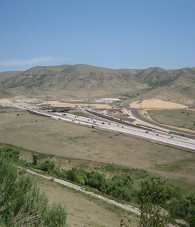
Reserved
Regulate intrastate commerce

Slide 55
Regulate interstate commerce

Slide 56
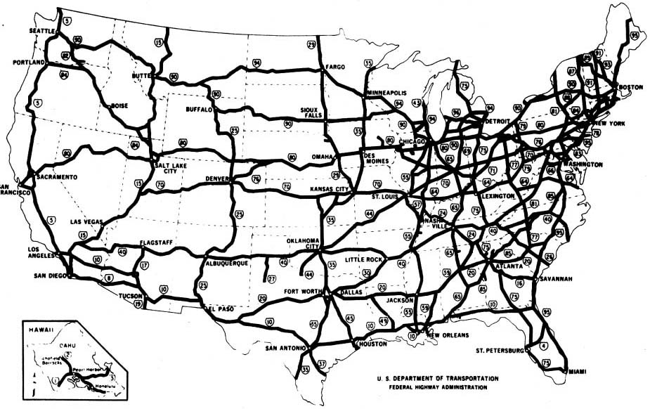
Delegated
Regulate interstate commerce

Slide 58
Delegated
Reserved
Concurrent
Establish local governments
Protect copyrights and patents
Guarantee and protect civil liberties and rights
Establish Schools
Negotiate Treaties
Regulate marriages, divorces, and adoptions
Punish lawbreakers
Regulate immigration
Construct and maintain roads
Provide fire and police protection

