Slide 1
Civic Participation

Slide 2
Types of Citizens

Slide 3
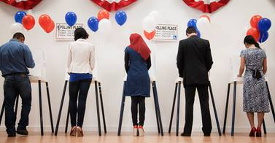
Electoral Specialists
Types of Citizens

Slide 4
Civic Specialists
Electoral Specialists
Types of Citizens

Slide 5
Dual Activists
Civic Specialists
Electoral Specialists
Types of Citizens

Slide 6
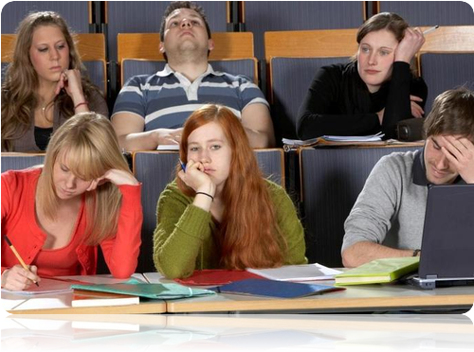
Disengaged
Dual Activists
Civic Specialists
Electoral Specialists
Types of Citizens

Slide 7
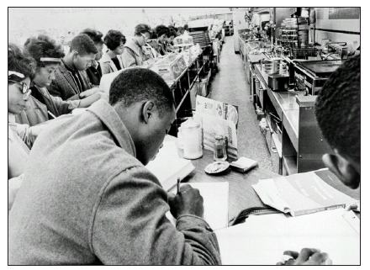

Slide 8
What details do you see?

Slide 9
What actions do these people appear to be taking?

Slide 10
What problem(s) do you think these people were trying to address?

Slide 11
What do you think was the result of their actions?

Slide 12
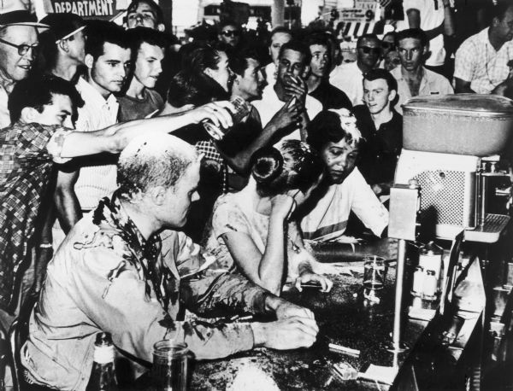

Slide 13
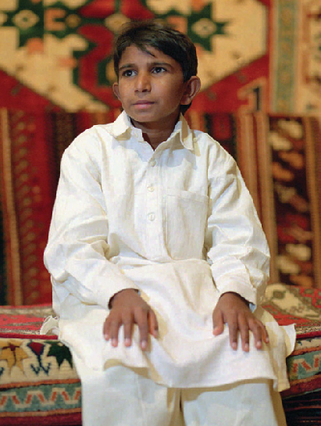
Case
Study #1

Slide 14
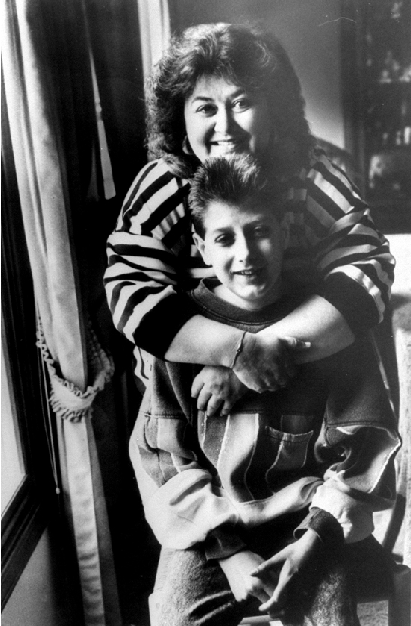
Case
Study #2

Slide 15
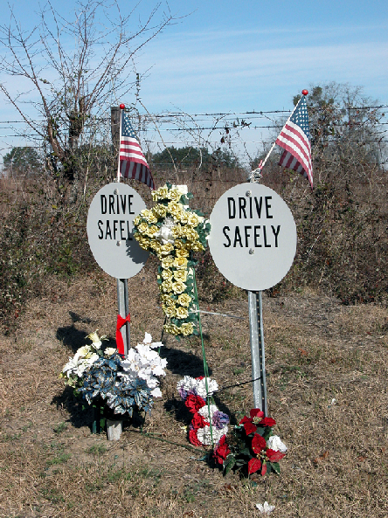
Case
Study #3

Slide 16
Iqbal

Slide 17
CARE Act

Slide 18
MADD

Slide 19
Not Effective
Highly Effective

Slide 20
How can ordinary people make a difference in a democratic society like the United States?
PEA

